Slide 1

F. Scott Fitzgerald’s
The Great Gatsby

Slide 2
Topics
Love
Death
Class
Wealth
The American Dream

Slide 3
Free-write
Using an extended METAPHOR, write a paragraph to vividly describe your Generation.
Violet, Skeleton, Valley, Maze, Amoeba, Fruit, Water, Altar, Library, Diamond, Purse, Balloon, Hinge, Battery, Spice, Armor, Bell , Fountain, Window, Robot, Seed, Menu, Rainbow, Prison, Water, Monster, Satellite, Safe, Key, Muscle, Sauce, Ladder, Nest, Saloon, Fawn, Landslide, Machine, Prism, Lever, Shadow, Smoke, Map, Microscope, Pendulum, Horizon, Perfume, Magnet, Zoo, Fungus, Grave, Swamp, Bruise, Engine, Candy, Detour, Current, Bottle, Feather, Ghost, Clock, Compass, Statue, Library, Mouse.

Slide 4
Best Novels Ever?
Always in the Top 10.
Novels that Defined Generations

Slide 5
Generations
Generation Title
Greatest Generation
Baby Boomers
Generation X
Millennials
Generation Z
Other Names
G.I. Generation
Silent Generation
Boom Generation
Hippie
MTV Generation
Generation Y
New Silent Generation
(Work Hard/Keep Quiet)
Born
1901 - 1924
1925 - 1945
1946 - 1964
1965 – 1985
1978 - 1994
1995 -
Notable Events/ Presidents
Experienced WWII in adulthood
John F. Kennedy & Richard Nixon
Experienced WWII in childhood, Civil Rights Movement, Space Exploration, Counterculture, Vietnam War/Cold War, Bill Clinton & George W. Bush & Donald Trump
Rise of Mass Media/end of the Cold War, Barrack Obama
Rise of the Information Age/Internet/9-11/Iraq War/New Workplace Rules
Great Recession, Digital Globalization, ISIS, Living with Climate Change

Slide 6
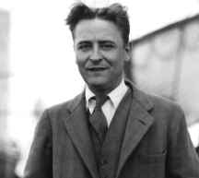
About the Author
Born-September 24, 1896
Died-December 21, 1940
Married Zelda Sayre
Famous works include The Great Gatsby
The Beautiful and the Damned
Tender is the Night

Slide 7
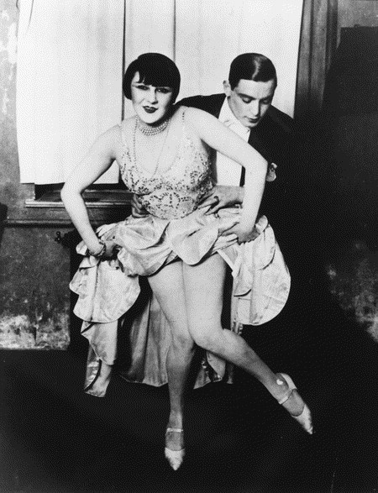
F. Scott Fitzgerald’s Impact on Society
Fitzgerald named the 1920’s “The Jazz Age”
Wrote screenplays for Metro-Goldwyn-Mayer
Created the The Great Gatsby which is said to be the most accurate description of the 1920’s

Slide 8
The Jazz Age
Prohibition was in effect (outlawing alcoholic beverages).
Dances such as the Charleston were popular
Popular sayings included 23 Skidoo, Bee’s Knees
Economy was in a “Boom”

Slide 9

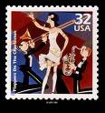
The Flappers
Flappers were women who rebelled and changed fashion and social norms of the early 1900’s.
They married at a later age and drank and smoked in public
Flappers were known for their carefree lifestyles.

Slide 10


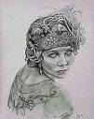

Flapper Fashion
Flappers dressed in shapeless dresses that came to the knee.
Dresses were made to look “boy-like”
Gender bending was common. Women would try to make themselves look more man-like.

Slide 11
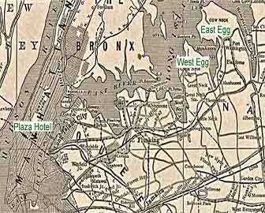
Settings in The Great Gatsby
West Egg- where Nick and Gatsby live, represents new money
East Egg- where Daisy lives, the more fashionable area, represents old money

Slide 12
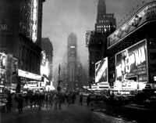
Settings in The Great Gatsby
The City- New York City, where the characters escape to for work and play
The Valley of Ashes- between the City and West Egg, Wilson’s stations is here

Slide 13
Death
After reading the article:
What is it about?
Where is it happening?
How is this happening?
Why do we care?

Slide 14
Charting Death
Draw 5 horizontal lines on your paper.
On the Y axis, label each: “15”, “25”, “35”, “45” and “55”
On the X axis, evenly distribute the numbers 1-10.
Using an ! as a marker, predict the emotional turmoil your death would cause at each age(subjectively, but to those who know you).
Using a $ as a marker, predict the financial turmoil your death would cause at each age (subjectively, but to those who know you).

Slide 15
Free-Write
Using an extended METAPHOR, write a paragraph to vividly describe love as…
Violet, Skeleton, Valley, Maze, Amoeba, Fruit, Water, Altar, Library, Diamond, Purse, Balloon, Hinge, Battery, Spice, Armor, Bell , Fountain, Window, Robot, Seed, Menu, Rainbow, Prison, Water, Monster, Satellite, Safe, Key, Muscle, Sauce, Ladder, Nest, Saloon, Fawn, Landslide, Machine, Prism, Lever, Shadow, Smoke, Map, Microscope, Pendulum, Horizon, Perfume, Magnet, Zoo, Fungus, Grave, Swamp, Bruise, Engine, Candy, Detour, Current, Bottle, Feather, Ghost, Clock, Compass, Statue, Library, Mouse.
It is NOT patient, kind, a rose, or a battlefield.

Slide 16
American Dream
http://www.youtube.com/watch?v=ltZGv1A971Q
What?
Where?
How?
Why?

Slide 17
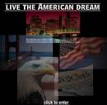
The American Dream
Gatsby is the ideal image of one who has achieved the American Dream… or is he?
What is the American Dream?
Who has achieved it in our time?

Slide 18
Answers
F Scott Fitzgerald
Zelda
Jazz
Prohibition
Charleston
Knees
Boom
Flappers
Old
New
D- Inlets

Slide 19
Characters in The Great Gatsby
Jay Gatsby- The mysterious man who lives next door to Nick Carraway C
Nick Carraway- the narrator, Daisy’s cousin, Gatsby’s neighbor D
Daisy Buchanan- socialite married to Tom B
Tom Buchanan- Daisy’s rich husband, former football player, has an affair with Myrtle G
Myrtle Wilson- Tom’s woman in the city, married to George E
George Wilson- owns the gas station F
Jordan Baker- Daisy’s friend, professional golfer A

Slide 20

Class Issues
New Money:
Someone who has achieved the American Dream
Not as respected in the 1920’s
Old Money
Money from family wealth
Born rich
Not earned through work done by yourself
Respected above all in the 1920’s

Slide 21
Depth and Complexity: Wealth
Language
Details
Patterns
Unanswered Questions
Rules & Trends
Ethics
Big Ideas Across the Disciplines
Changes over Time
Different Perspectives
Come up with three bullet points to illuminate your understanding – answer the questions. Make a connection by telling an anecdote or story from the news (like Chris Rock) that adds depth. Draw an Icon representing your in-depth inquiry. Take a pic to add to your slide. Make a one-slide presentation.

Slide 22
Symbols
A symbol is an object, action, or event that represents something or that creates a range of associations beyond itself. In literary works a symbol can express an idea, clarify meaning, or enlarge literal meaning.

Slide 23
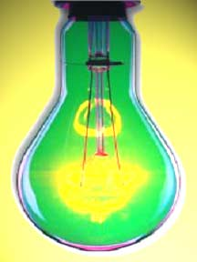
Symbols in The Great Gatsby
Green Light- at the end of Daisy’s dock and visible from Gatsby’s mansion. Represents Gatsby's hopes and dreams and love for Daisy, his attempts to fit into the old money “class” system (cash is green), because he wants Daisy to approve of him.

Slide 24
Symbols in The Great Gatsby
The Valley of Ashes-
The area between West Egg and New York City. It is a desolate area filled with industrial waste. It represents the social and moral decay of society during the 1920’s. It also shows the negative effects of greed.

Slide 25

Symbols in The Great Gatsby
The Eyes of Dr. T. J. Ekleburg-
A decaying billboard in the Valley of Ashes with eyes advertising an optometrist. There are multiple proposed meanings, including the representation of God’s moral judgment on society.

Slide 26
Symbols in The Great Gatsby
Tom’s Apartment
The overstuffed “love shack” that Tom has parties in and meetings with his girl-on-the-side, Myrtle. Represents the decadence and disgusting nature of the rich both in how it is furnished and what takes place inside.

Slide 27
Clocks
Represents the march of time. In important moments, clocks acknowledge how time moves us forward. As we all know, Gatsby wants to return back to a time when he could freely love Daisy, and have that love returned.
In the book, time figuratively stands still, slows down, or rapidly moves forward – mercilessly reminding each character, that circumstances often dictate their lives and not their own intentions.
You can’t defeat time (see the final sentence in the book if you REALLY want to be depressed)

Slide 28
Gatsby’s Mansion
The SIZE or capacity of Gatsby’s love for Daisy is symbolized throughout the novel.
He refurbishes his mansion directly across the bay from her so he can look at his Green Light.
He painstakingly updates the mansion, every room or outdoor feature with Daisy in mind.
Check out the scene where she first visits Gatsby’s bedroom. PACKED with symbolism.
However, the history of the mansion predicts a GLOOMY end for Gatsby’s love.

Slide 29
Symbolism Free-Write
After reading the first three paragraphs of Chapter 2 AND the first two paragraphs on page 29 describing the apartment (The Great Gatsby), see if you can identity any symbols. Using the text, make a claim, support it with textual support, and then comment on why you think the symbol means what it means.

Slide 30
Love = HW/ In class
Quickly draw one of the symbols/motifs AND
Write a poem, never to be published, emphasizing either the effect of TIME of Gatsby’s his love for Daisey, or the SIZE of his passion for her.

Slide 31
Important Quotes
“I hope she’ll be a fool- that’s the best thing a girl can be in this world, a beautiful little fool.”
Daisy’s description of her daughter

Slide 32
Important Quotes
"They were careless people, Tom and Daisy- they smashed up things and creatures and then retreated back into their money or their vast carelessness or whatever it was that kept them together, and let other people clean up the mess they had made." – Nick’s description of Tom and Daisy

Slide 33
Important Quotes
“So we beat on, boats against the current, borne back ceaselessly into the past.” –the last line of the novel

