Slide 1
Power Paragraphs
Refresher

Slide 2
Making a claim from a large question…
Step 1: Look at, and think about, your observations about the text/image.
Step 2: Answer your question using your textual evidence.
You just need to be able to prove it!
Step 3: Ask yourself: is this an interesting and unique idea?? (Is it too obvious?)
If it’s not, your reader is going to be bored.

Slide 3
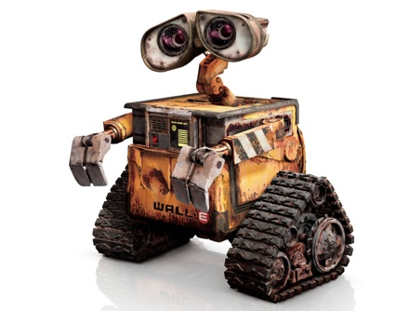
Example:
Large Question:
Does the film support a credible prediction of a trash-filled Earth?
Observations and Evidence:
The film is supposed to take place in the “distant future.”
The people on the space craft don’t even remember living on Earth.
When the people do remember earth, they really want to come back.
The people can’t take care of themselves – they need help getting up when they fall.

Slide 4
Claim:
The film Wall-E serves as a warning that we should take care of our planet for future generations or face a potential future of dependence on impersonal and soulless corporate care givers.
Evidence 1: The consequences of not taking care of it – having to leave.
Evidence 2: The lack of individualism and identity, instead given over to corporate influences.
Evidence 3: How incapable the people on the ship were at taking care of themselves.

Slide 5
Introduce
Introduce: evidence or quotes with background information
Who is speaking? To whom? Why?
What is the setting (time/place)? Why?
What is the source( especially if this is your first time referencing)
- Who is the author? Credentials? Why reliable?

Slide 6
Explain
Explain, in your own words, what you see as important in the evidence.
If using a quote: Put quote into your own words
Describe what in evidence is most important
- It has to be important to your claim…or the quote/evidence won’t work.

Slide 7
Pertain
PERTAIN evidence back to your thesis (point of paper)
What is the connection between the quote/evidence and your thesis?
Why are using this as support?
HOW is it supporting your thesis?
This supports my claim because_________.
This proves my point because_________.
This shows _______ because _______.

Slide 8
Chart It
You have a claim, and three pieces of evidence.
Write an outline of a power paragraph using Introduce, explain, pertain (that we just reviewed!)
Complete a graphic organizer that looks like the one on the following screen

Slide 9
