Slide 1
AP Lang
In the beginning…

Slide 2
Rhetoric
Why Study Rhetoric (The Art of Language)
Professions

Slide 3
What is REAL?
Plato’s Allegory of the Cave
Held in a Cave, chained so the only thing you could see is shadow, wouldn’t your mind form what it thought a book looked like?
It’s only a book once you see it and called it so!
Therefore, it is possible to TEACH your mind to see things differently.
If you do, YOU MAKE IT SO.

Slide 4
New Way of Thinking
Everything is an Argument
WHY AGAIN?
To Get a “Five”
To Get Cash Money
To Discover Something New
To Become Truly Passionate

Slide 5
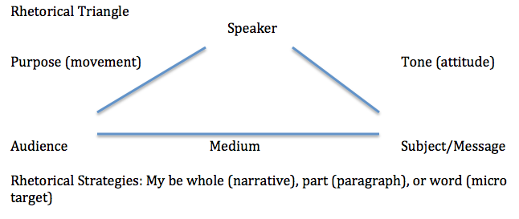
Rhetorical Triangle

Slide 6
Roles
Speaker: Words or a Whole Persona
Audience: Those the Author Seeks to Change
- Who
- Why?
Subject: / Message : How does the speaker FRAME the argument?
Purpose: What movement does the speaker seek?
Tone: What it the author’s attitude?
Medium: What is the delivery system?

Slide 7
Aristotle’s Means & Modes
MEANS = HOW (speaker moves the audience)
Logical Appeal (Logos): To REASON Clearly
Ethical Appeal (Ethos): To UNDERSTAND THE GOOD in its various forms. This is a value argument. Audience Determines Everything; if you can’t understand the values of your audience, you can’t move them.
Emotional Appeal (Pathos): To UNDERSTAND THE EMOTIONS. Are you fluent – do you speak the right emotional language to appeal to your audience?

Slide 8
Aristotle’s Means & Modes
MODES = WHAT (speaker does to persuade)
Logical Appeal (Logos): PROOF (Rhetorical Mindset). APPARANT PROOF (Data that either becomes or does not).
Ethical Appeal (Ethos): CHARACTER of the speaker –Credibility is everything.
Emotional Appeal (Pathos): To PLACE (Setting) the audience in the right frame of mind. Get them to listen, keep them there, then move them to your side.

