Slide 1
Mock Exam
Class Data

Slide 2
The Fantastic
Legacy wants slightly more than a 1/3 of all AP Lang students (90) to get a qualifying score of “3” or higher = (about 32 students at SHS)
Mr. Frick’s class by itself = 15!
2012 test regarded as “the toughest in years.”
You took Mock exam on a Friday, having only looked at MC once, and only looked at Argumentative Essay once.
Skyline is proud to claim not one, but two, “5’s”!

Slide 3
The Almost
Of the 13 of you who got a “2”, THREE of you missed a qualifying “3” by one point…. One more MC right, one tick up one of your essays, you would have done it.
Of the seven of you who got a “3”, TWO of you missed a sweet-as-honey “4” by one point… One more MC right, one tick up one of your essays, you would have done it.
Of the seven of you, SEVEN my goodness in this class, who got the sweet-as-honey “4’s”, two of you were two points from the hallowed “5.”

Slide 4
Synthesis Paper
Mock Exam Results, Re-writes, and Research Paper Comments

Slide 5
The Exam
Each exam is out of 9 points. A “5” is considered passing/adequate.
Remember, a 55% on the MC with “5’s” on the essays will safely land you a qualifying “3”.
Randomized and graded by AP Lang teachers. Neither Everson or I could grade any of our own students.
Table readers provided “second” readings on any close calls.
If you see a change of score, your paper was read twice and the table reader chose to ”trump” over the initial reader. This could mean you went up or down.

Slide 6
Mock Exam: Synthesis
9 = 0
8 = 2
7 = 1
6 = 6
5 = 12
4 = 5
3 = 6
Average = 4.9
Qualifying Scores: 21

Slide 7
Prompt & Thesis:
THREE PROMPT KEYS:
1. Identify Subject: Wealth Gap, Education (Politics, Pursuit of Happiness, Standard of Living), Who (What Narrow Group).
2. TAKE a Position on X. ASK: What are the Problems or Issues?
3. Fix the problem on X. ASK: What are the solutions or criteria?
Write out your THESIS (take a position) even before you have read your sources, so that the thesis ADDRESSES the PROMPT!
Sample: Despite recent attempts to bridge the wealth gap among Samoan teenagers, high tuition and obesity plague any real progress, and only free college and organic lollipops will restore their faith in the American Dream.

Slide 8
Introduction
FRICK WRONG to tell you to just write the thesis.
It will get you a five-seven. But after looking at your scores, write an introduction EXACTLY how you wrote these research papers.
Quote: Literary Reference!
Vivid Description
Metaphor: Dom’s Door*
Anecdote
Rhetorical Questions or two.
*TIP: Good place to use poetic devices.

Slide 9
Conclusion
So What Statement? (So Fricking What)
First sentence: Re-state, and re-answer the prompt with a rewording of your thesis. (Include subject, position, solution/criteria).
THEN, make a holy-cow-is-this-so-profound-so-what?-let-me-tell-you-what-is-so-profoundly-what!!! Statement.
Tip: Good place to use poetic devices.

Slide 10
Body Paragraphs: THREE or DIE!
TOPIC sentence THAT IS NOT A SOURCE QUOTE but a sentence that INTRODUCES A TOPIC.
Somoan Americans remain vastly undereducated.
Conversation: At least THEE sources (4) integrated with your Commentary!
Include a SHORT introduction of the source, then give a paraphrase or short quote, then give RELATED COMMENTARY
Ken Bigshot, a CNN commentator reports that “three hundred thousand” Samoan Americans are Walmart employees without college educations (Source A). Meanwhile Lupita Lovestotalk, a talk-show host, declares that working at Walmart is “just as good as a college degree.” (Source C). Bigshot is clearly right. Lovestotalk marginalizes Samoans to the retail life while Bigshot sees the lack of education as a detriment, not something he is okay with. Clearly, Samoans are underrepresented among Americans with higher degrees and this represents a huge problem. The key to achieving the American Dream and upward mobility is a college degree. This is an enormous problem needing a solution.

Slide 11
HW and In Class = Re-writes:
Re-write Research Paper for higher grade. Email me to let me know you have done this.
Re-write synthesis essay in class today using strategies and tips from this power point.

Slide 12
New Prompt – Write an Introduction
Directions: The following prompt is based on the accompanying eight sources.
This question requires you to synthesize a variety of sources into a coherent, well-written essay. When you synthesize sources, you refer to them to develop your position and cite them accurately. Your argument should be central; the sources should support the argument. Avoid merely summarizing sources.
Remember to attribute both direct and indirect references.

Slide 13
Prompt
Introduction
Explorers and tales of explorations tend to capture the human imagination. However, such explorations have financial and ethical consequences. Space exploration is no exception.
Assignment
Read the following sources (including the introductory information) carefully. Then, in an essay that synthesizes at least three of the sources, develop a position about what issues should be considered most important in making decisions about space exploration.

Slide 14
Argumentative
Mock Exam Results, Re-writes

Slide 15
Mock Exam: Argumentative
9 = 0
8 = 3
7 = 3
6 = 6
5 = 5
4 = 6
3 = 6
2 = 1
0 = 2
Average = 4.8
Qualifying Scores = 17

Slide 16
General: Defend. Refute. Qualify
The defend, refute, qualify essay asks the student to take a stance on another’s position. In essence, the student is defending or challenging the position of a known writer.
Typically the student is given a subject area and enough information within the prompt to fashion a reasonable response. Students are expected to have some basic knowledge of the subject.

Slide 17
Take a Position and Examine The Relationship Between Certainty and Doubt
Examine the language of the argument. Most arguments tend to “load the dice” by choosing key words or phrases that tilt the argument in their favor.
YOU FRAME the DEBATE:
Does certainty reflect or deny the values of society?
Does doubt reflect or deny the values of society?
Is certainty a celebration or an attack on success?
Is doubt a celebration or attack on success?

Slide 18
Only Four Essays You Can Write
There are four basic positions (thesis statements) one can take in a DRQ. D = Defend, R = Refute, Q = Qualify. The codes are in relation to the first author (or only one). In this case, the code is in relation to ‘”Certainty.”
The unqualified defense (Certainty is best.) Outline: Intro, R, R, D, D, Conclusion
The qualified defense (Certainty is mostly best, but with some reservations.) Outline: Intro, D, R, Q, Conclusion
The unqualified refutation (Doubt is best.) Outline: Intro, D, D, R, R, Conclusion.
The qualified refutation (Doubt is mostly best, but with some reservations.) Outline: Intro, R, D, Q, Conclusion

Slide 19
INTRODUCTION & THESIS
Use a hook
- Quote, Vivid Description, Anecdote, Question
- Background Information (metaphor) and develop your argument. Build with one or two examples (GOPHERS) that will be your position.
-Thesis that uses an “amplification verb” and a “because” statement with two to three reasons.
If you are able, qualify your position as well.
Qualified Refutation Thesis Example:
In the relationship between certainty and doubt, those who favor doubt will more likely discover success in life because it is doubt that inspires the most resourcefulness and invention; however it is true, that those who practice doubt may feel insecure about never feeling certain. (Outline: Intro, R, D, D, Q, Concl.)

Slide 20
Body Paragraphs
State a CLAIM – always use a claim as the first sentence of body paragraphs. Always. This is a topic sentence, dig?
For example, “Doubt leads to magnificent invention.”
Introduce and present your own evidence… For example, “The Wright brothers most assuredly heard the doubts that man would ever fly.”
Connect your example to the prompt and analyze it with commentary… For example, “If ever an endeavor encouraged less certainty than doubt, perhaps a human being actually flying would top the list. After all, humanity had just left behind horse-drawn carriages, what gumption gave us the idea to suddenly think we could jump off a cliff and fly like a bird?”
Use a transition sentence to introduce your next paragraph. For example, “While the Wright brothers fueled their triumph with the doubt of others, there is a cautionary side to doubt that leads to insecurity.”

Slide 21
Evidence For Body Paragraphs
It’s not the evidence you use; it’s how you use the evidence. Don’t feel boxed in by your evidence. Use your imagination and find a way to argue (reasonably and convincingly, of course) your position.
Government and current events
Observations and personal experience
Philosophy and psychology
History
Entertainment and pop culture
Readings
Science and technology

Slide 22
Conclusion
RE-state thesis:
- Reexamine the prompt and make sure you are taking a position and clarifying.
• Make a So- What Statement: Why is this a big deal?
- Talk your way in your conclusion into a higher score.

Slide 23
Rhetorical analysis
Mock Exam Results, Re-writes

Slide 24
Mock Exam: Rhetorical Analysis
9 = 0
8 = 1
7 = 1
6 = 9
5 = 7
4 = 5
3 = 2
2 = 5
0 = 2
Average = 4.5 (lowest)
Qualifying Scores = 18

Slide 25
Triangle
Speaker
Purpose
Tone
Audience
Subject
Medium

Slide 26
Introduction of New Chart

Slide 27
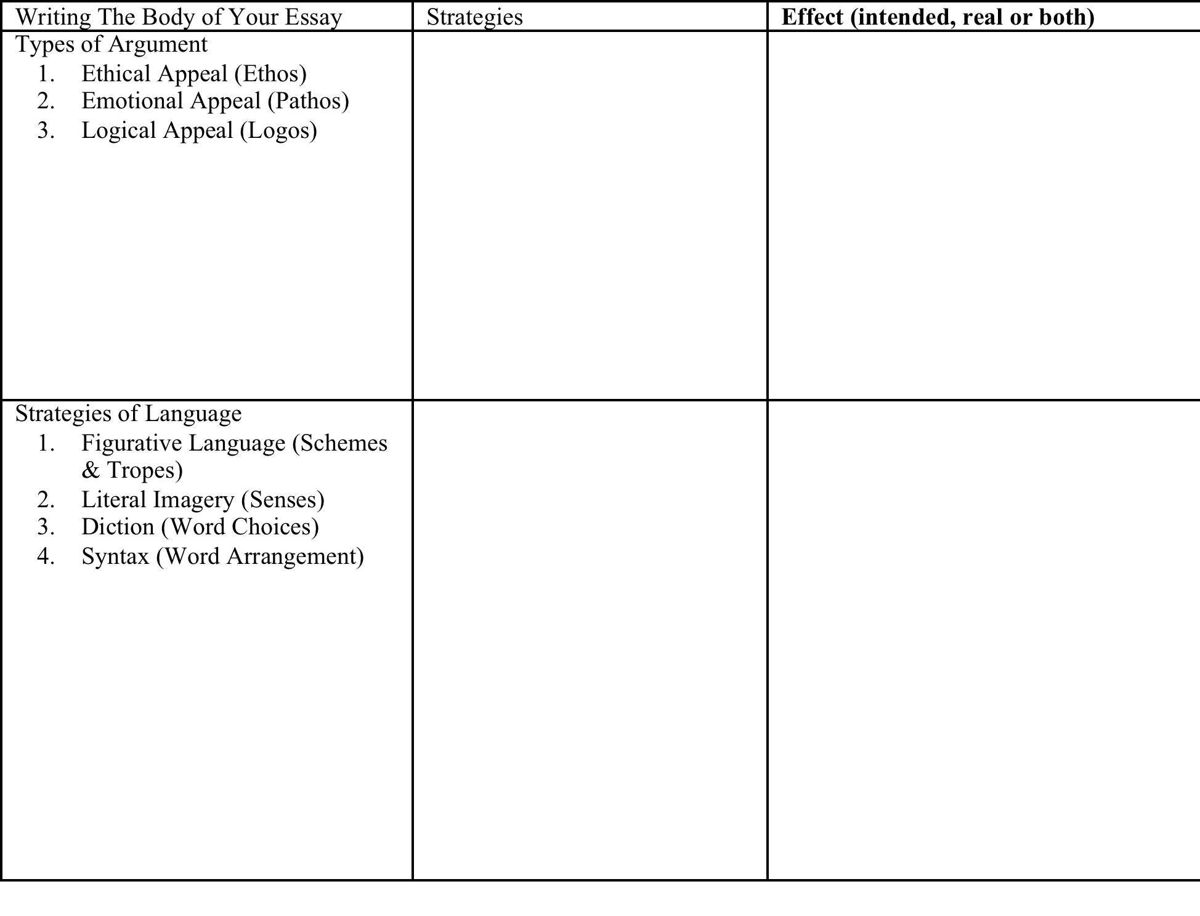
Body of New Chart

Slide 28
Conclusion of New Chart

